Slide 1

MOVIES SEARCH ENGINE
Assignment 1
October 06 2023

Slide 2

1
1
PROJECT OVERVIEW
2
PROBLEM STATEMENT
CONTENT
3
DATASETS
4
TASKS & TIMELINE
© Copyright FPT Software – Level of Confidentiality

Slide 3
01. PROJECT OVERVIEW

Slide 4

PROJECT OVERVIEW
The goal of this project is to build a movie search scripts based on titles, tags, characters, directors, etc.
The demonstration should suggest the top appropriate films.

Slide 5
02. PROBLEM STATEMENT

Slide 6
PROBLEM STATEMENT
Input
Keywords for movie name, tags, cast, description, etc.
Output
Top 5/10/… recommended movies.
Learning rule
Python string methods, processing files, etc.

Slide 7
03. DATASETS

Slide 8
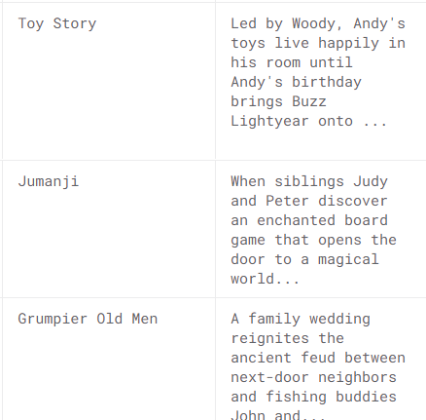
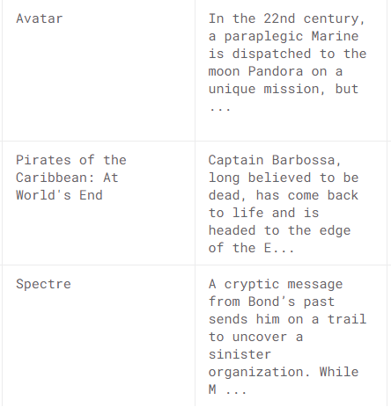
DATASETS
Any movies dataset with metadata is suitable for this task.
Ex:
https://www.kaggle.com/datasets/rounakbanik/the-movies-dataset
https://www.kaggle.com/datasets/tmdb/tmdb-movie-metadata
You can collect additional data for this challenge.
To make the project more simple, you can reduce the number of movies to hundreds.

Slide 9
04. TASKS & TIMELINE

Slide 10





TASKS
Data Understanding
Review/ Reports
Data Collection.
Data Processing.
Code review meeting.
Code planning meeting.
Understand Requirements
Coding
Clear the requirement.
Research, do experiments.
Design working flow.
Select and implement searching method.
Select and practice on scoring method.

Slide 11
TASK MANAGEMENT
Tools that can be used for task management.
Excel
Trello
Notion
Please learn to use at least one of these tool for manage tasks (requirements, PIC and deadlines)

Slide 12

CONTACT US
FPT Quy Nhon, Science Avenue, Ghenh Rang Ward, Quy Nhon City, Binh Dinh Province, Vietnam

